Slide 1
Progress Report
By: Anna Lebedeff, Mohamed Mkhaibou, Khoa Nguyen and Sami Valkamaa

Slide 2
Current Goal:
Implement SARIMA model.
Add credibility to the results, that is:
Improve visualization of the prediction, in the form of interactive plot
To test which year should the model start from to yield the best prediction
Implement SARIMA to evaluate its performance against Prophet => Find the optimal model
Start working on the report.

Slide 3
Visualization
Instead of using tradition matplotlib, plotly was implemented so that users can interact with the plot, see the value of each quarter as well as zoom in/out.

Slide 4
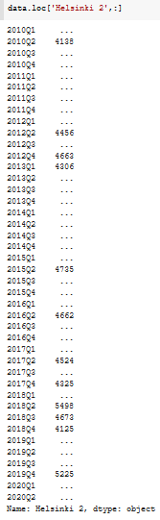
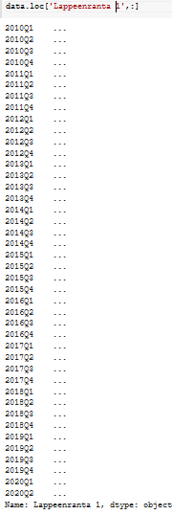
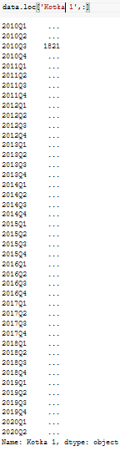
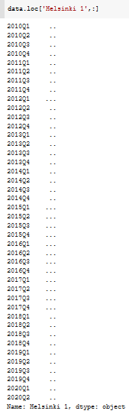
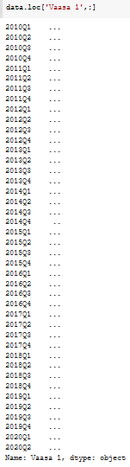
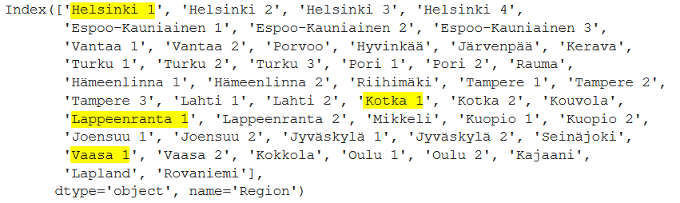
Terraced houses EDA

Slide 5
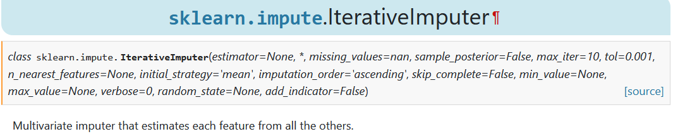
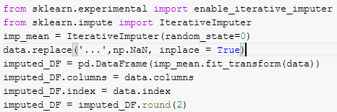
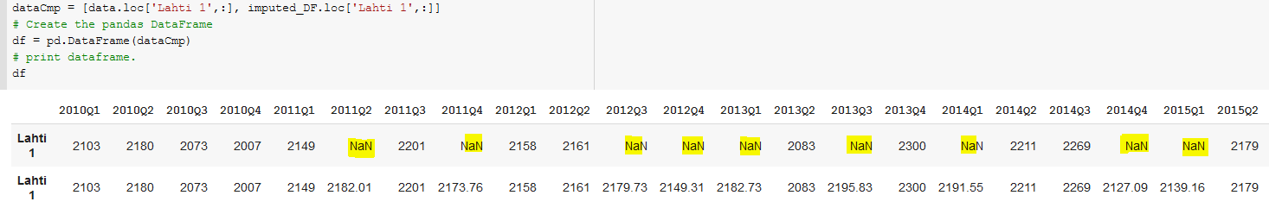
Terraced houses EDA

Slide 6
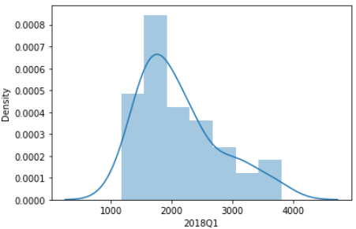
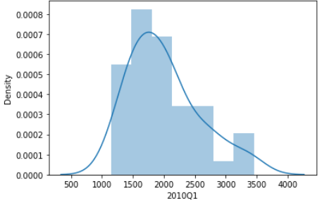
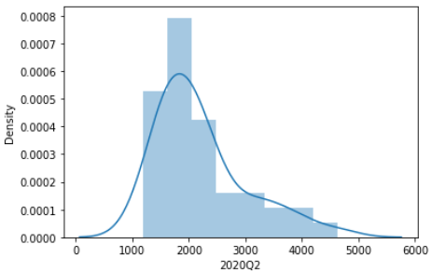
Terraced houses EDA

Slide 7
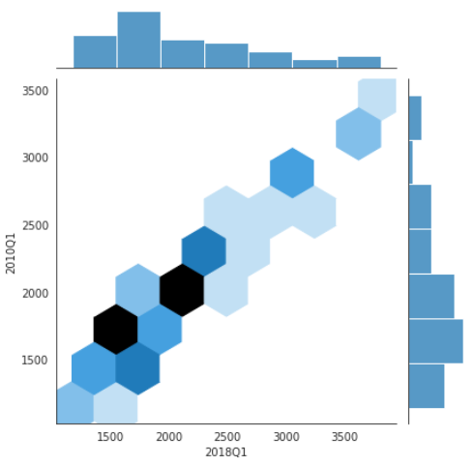
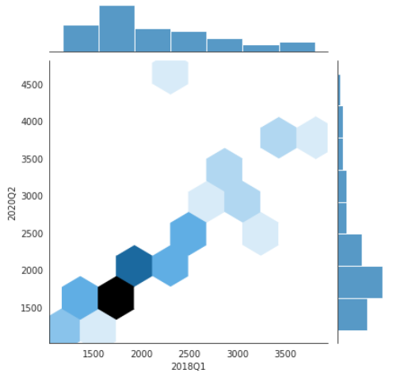
Terraced houses EDA

Slide 8
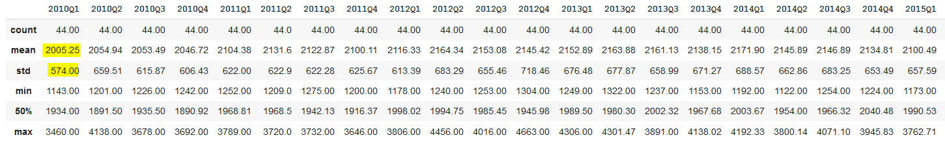

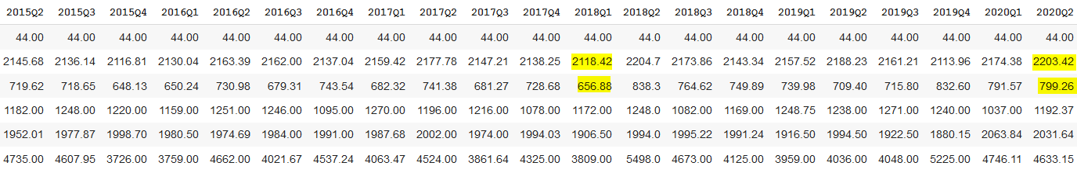
Terraced houses EDA
Mean diff btw 2010 Q1 & 2020Q2 = 198,17
Std diff btw 2010 Q1 & 2020Q2 = 225,26

Slide 9
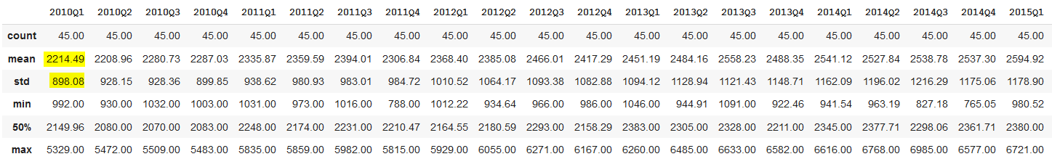
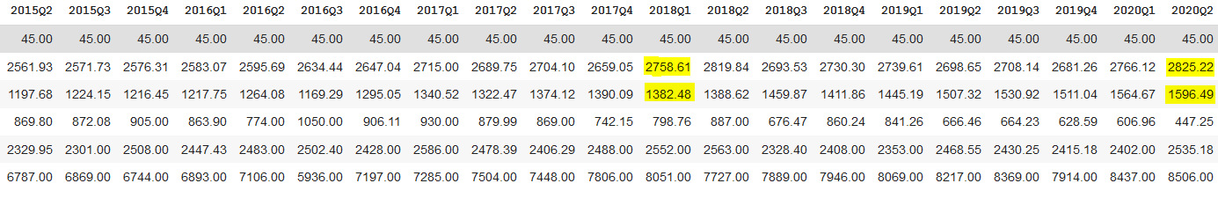
One-room flat EDA
Mean diff btw 2010 Q1 & 2020Q2 = 610,73
Std diff btw 2010 Q1 & 2020Q2 = 698,41

Slide 10
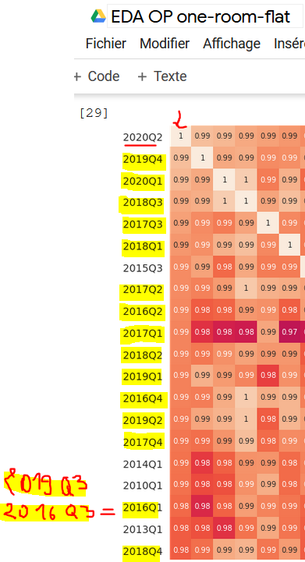
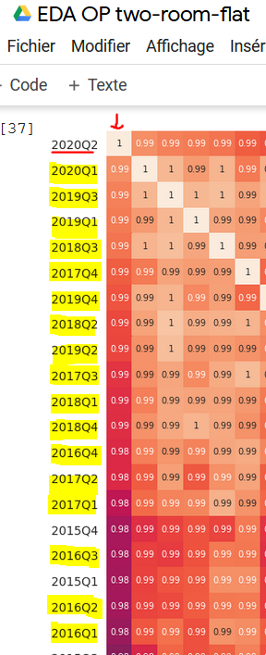
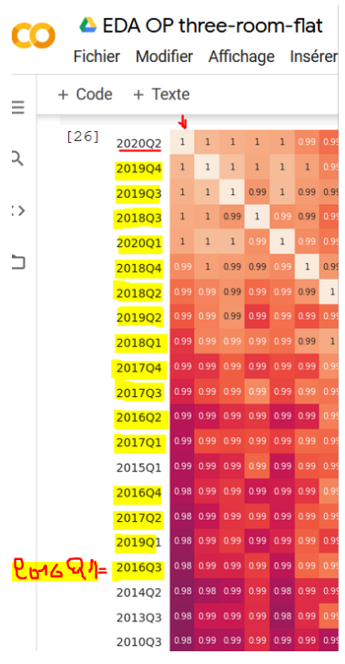
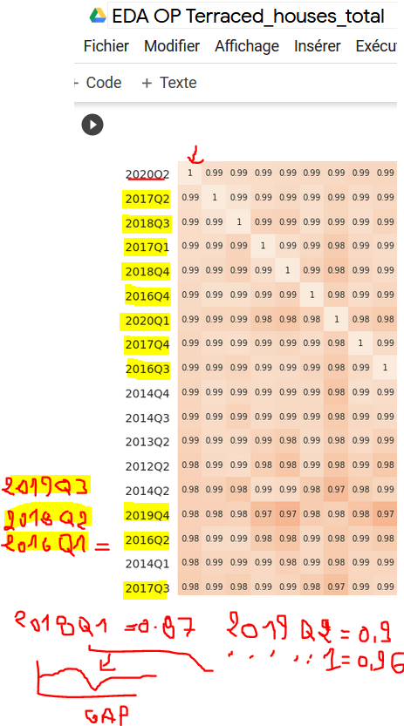
Correlations

Slide 11
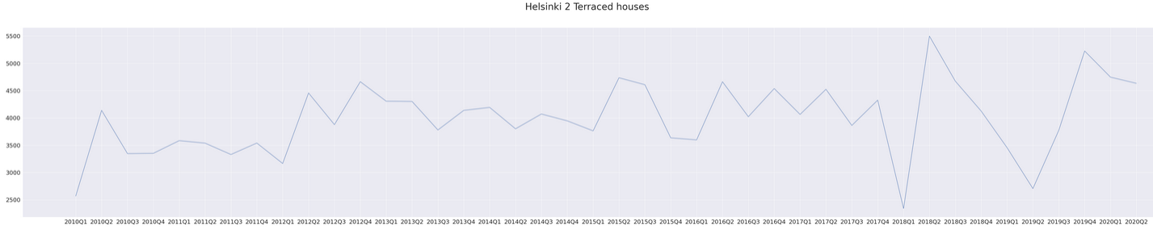
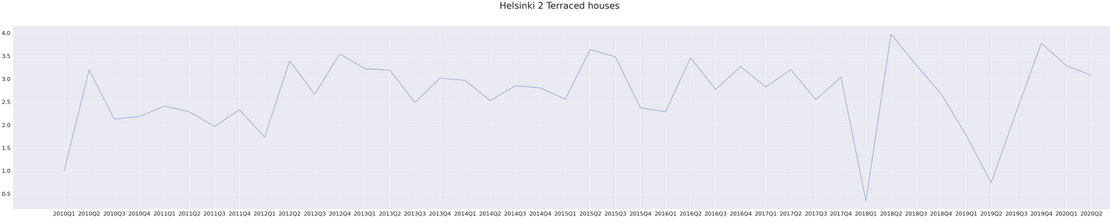
Terraced houses EDA

Slide 12
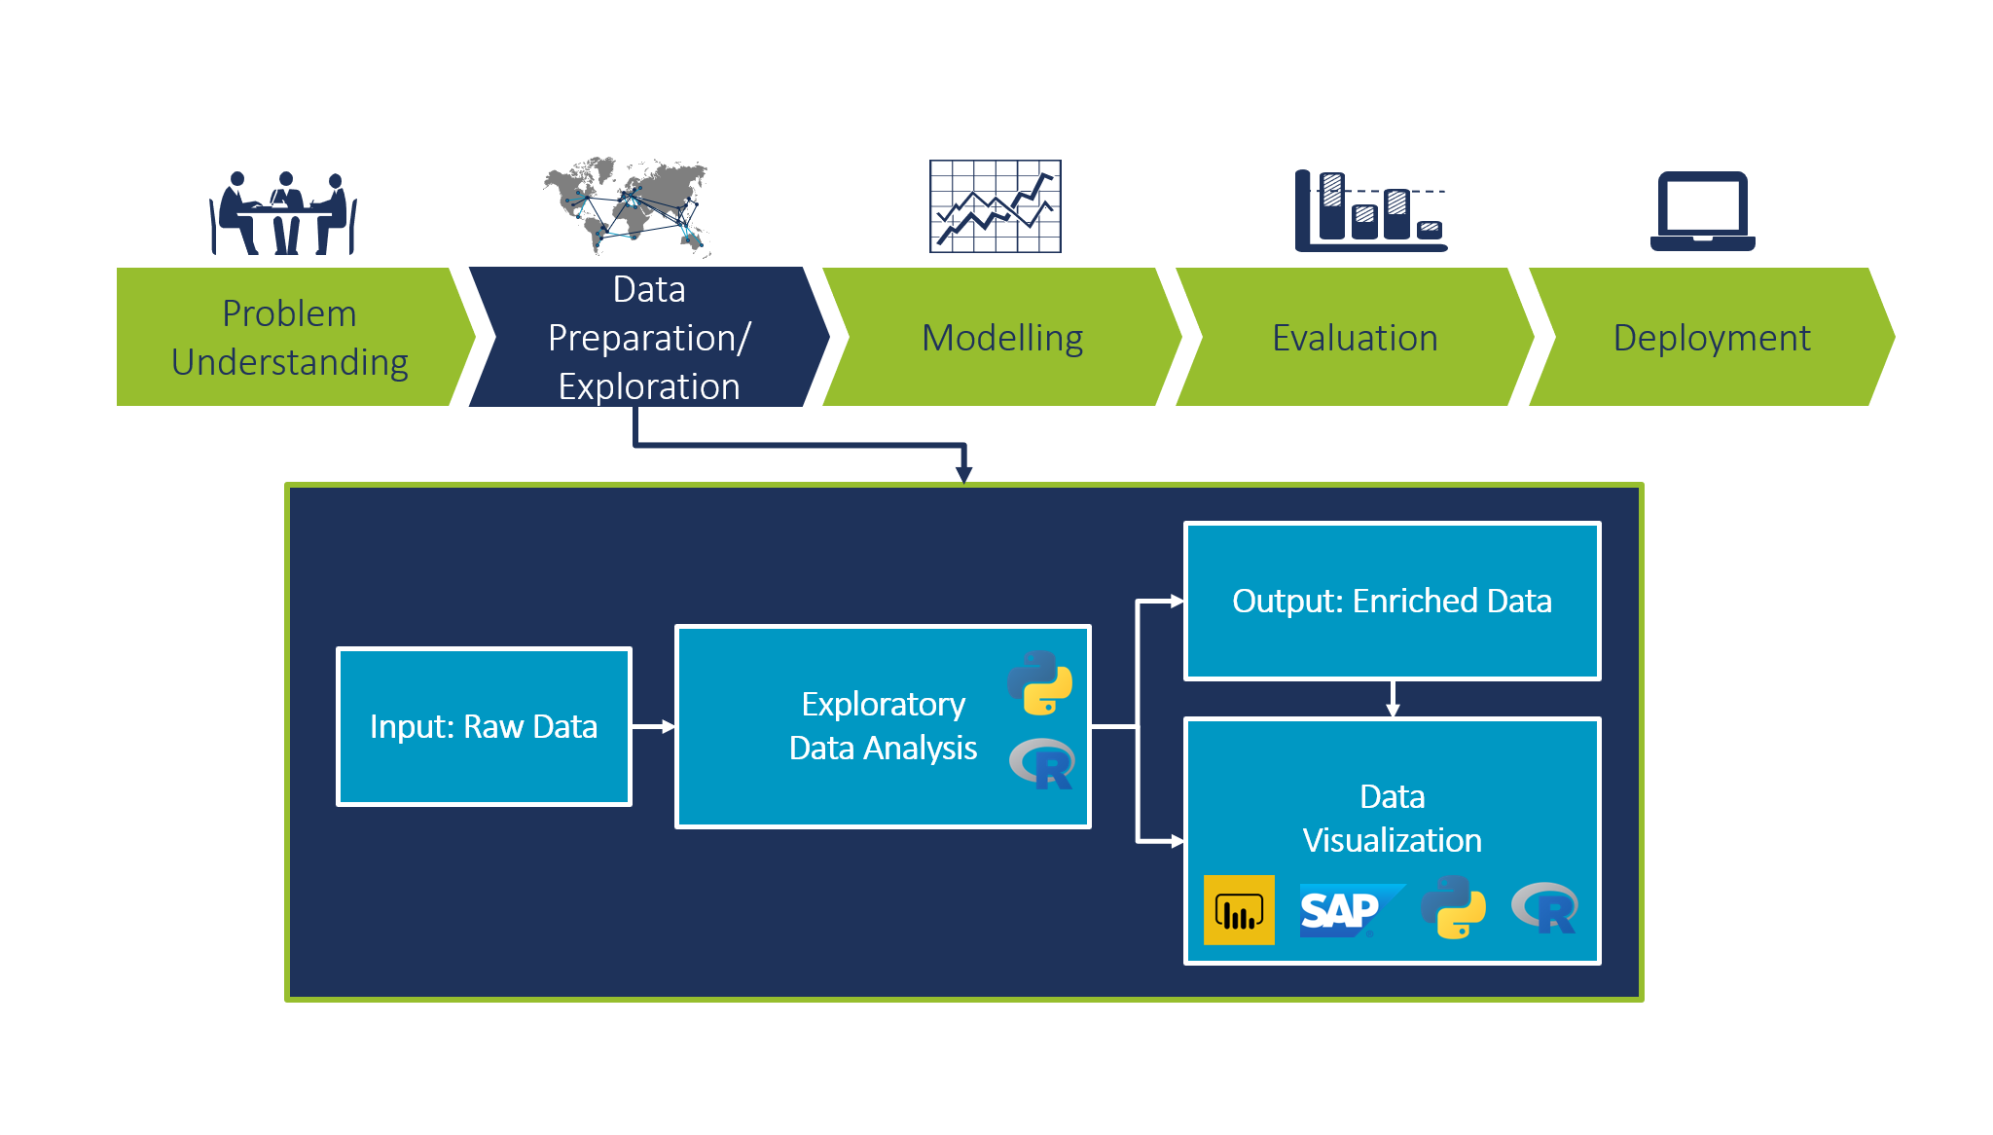
Where we are now:

Slide 13
Optimal start year
In order to find the optimal start year, two functions where created:
Both def split the data into 2 parts: training (i-2018Q4) and testing (2019Q1-2020Q2)
First function calculate each region individually, returning a table of MSE_linear and MSE_prophet of each year. The table can tell us for each region, which start year yield the best result for each model.
Second function calculate the MSE and MAE comparing the whole predicted dataframe with the original one.

Slide 14
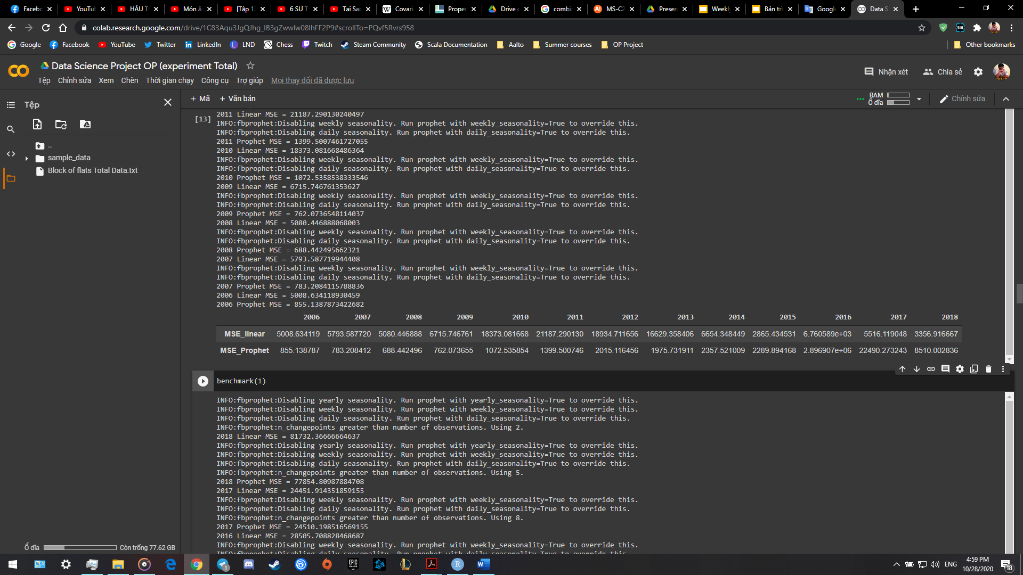
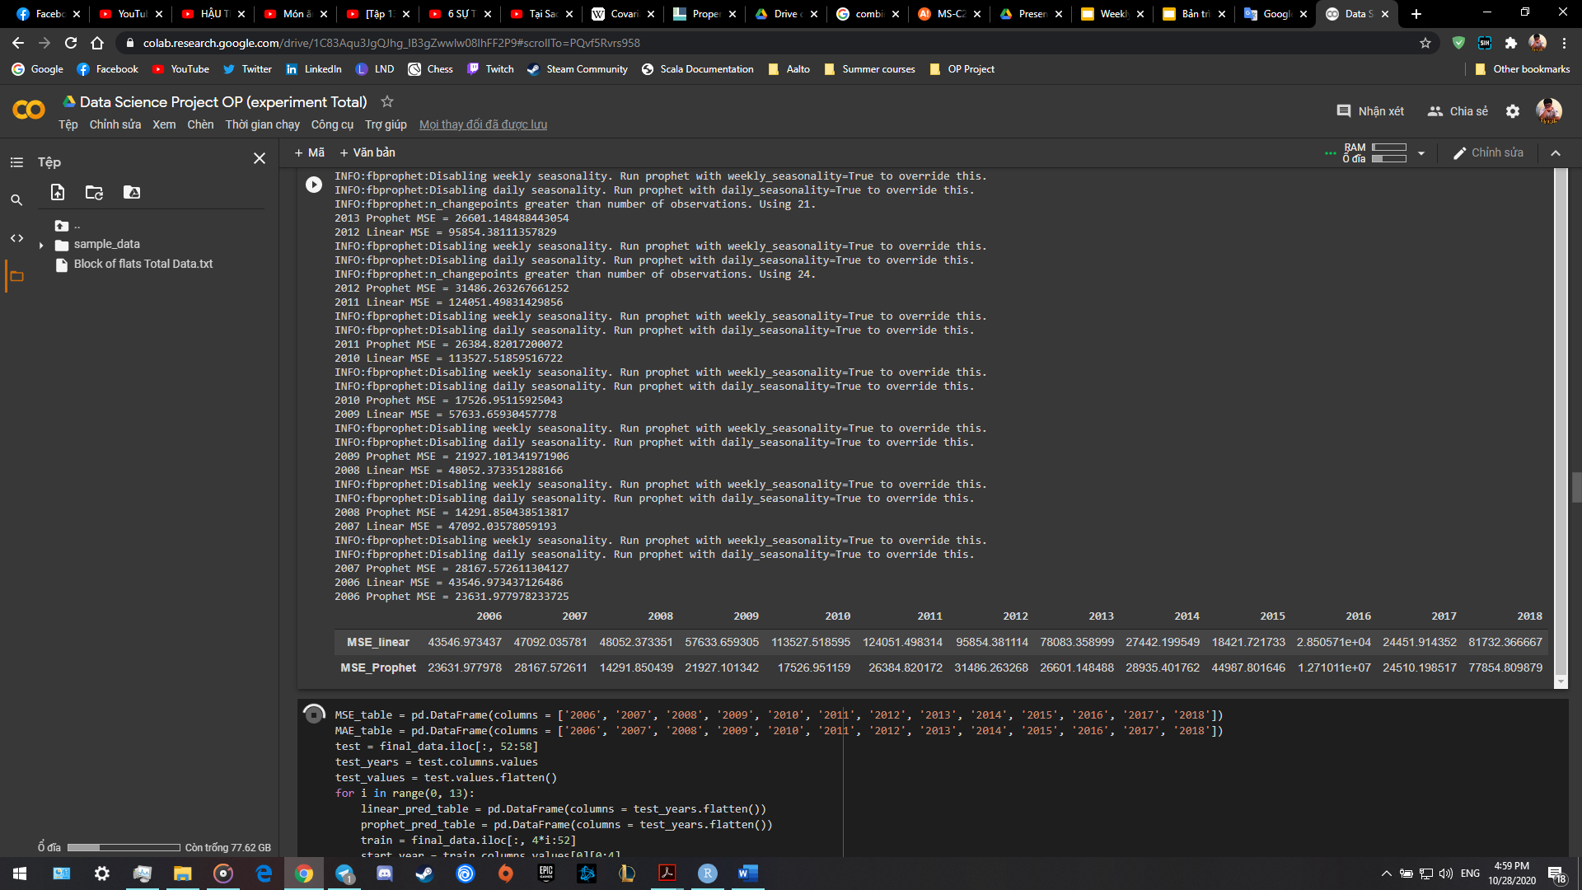
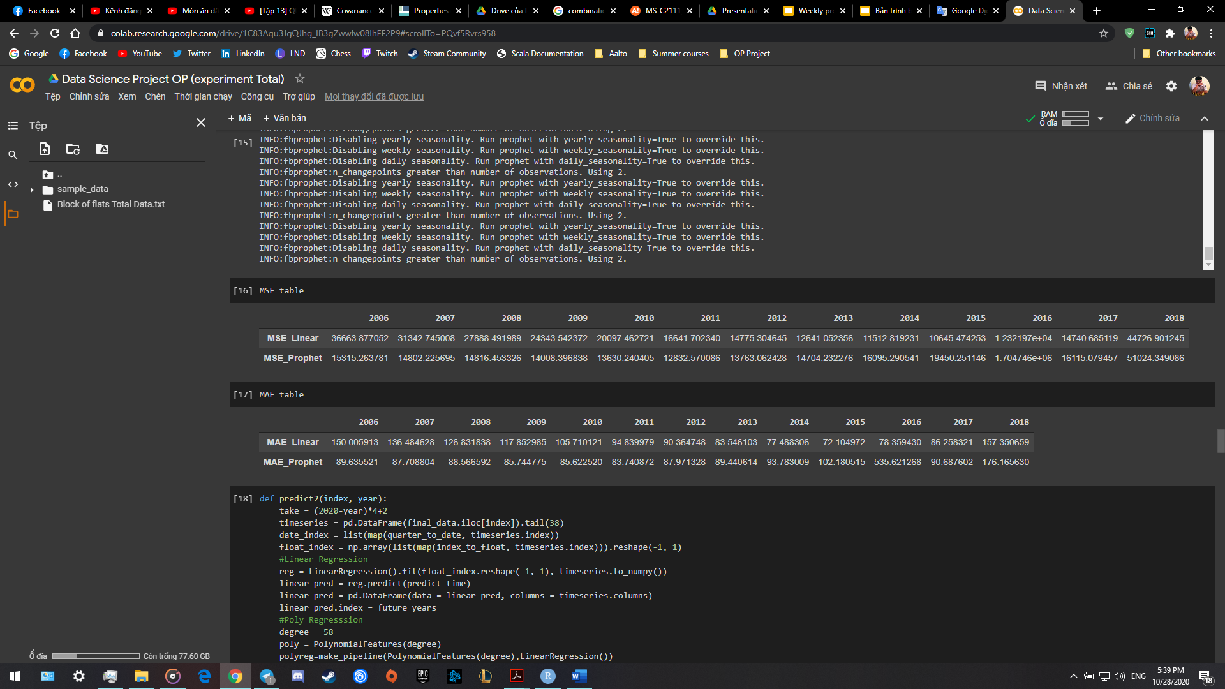
Optimal start year
Output of first function:
Helsinki region
Output of second function:
Helsinki 1 region

Slide 15
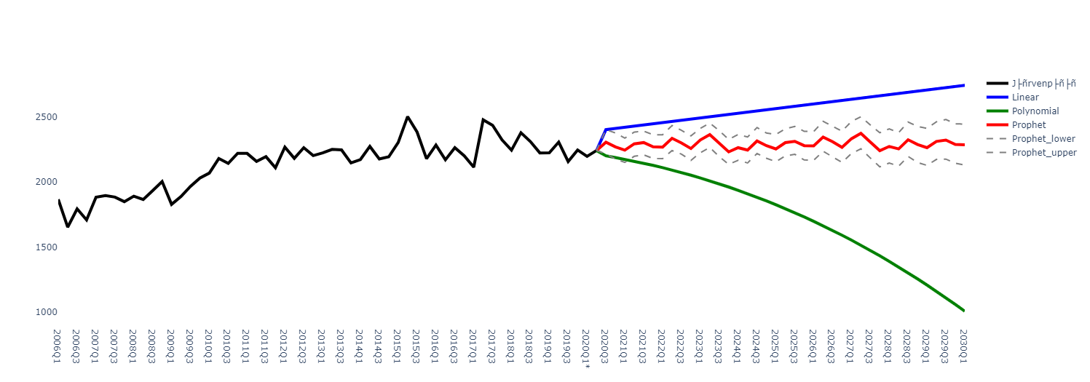
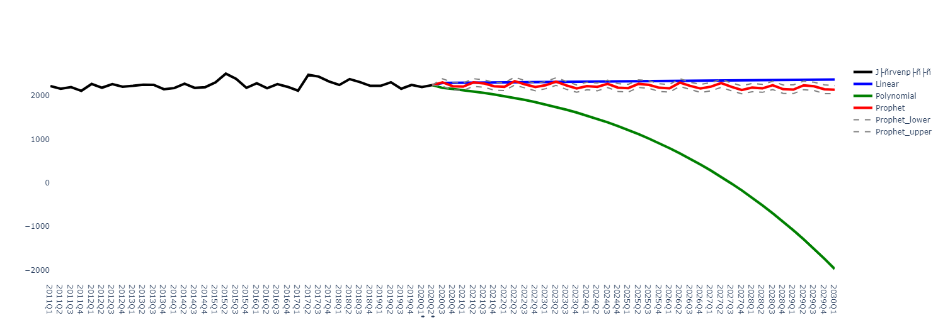
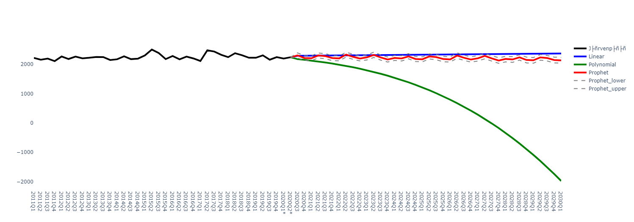
Some test prediction with different start year
Järvenpää
Järvenpää 2011
Järvenpää 2015

Slide 16
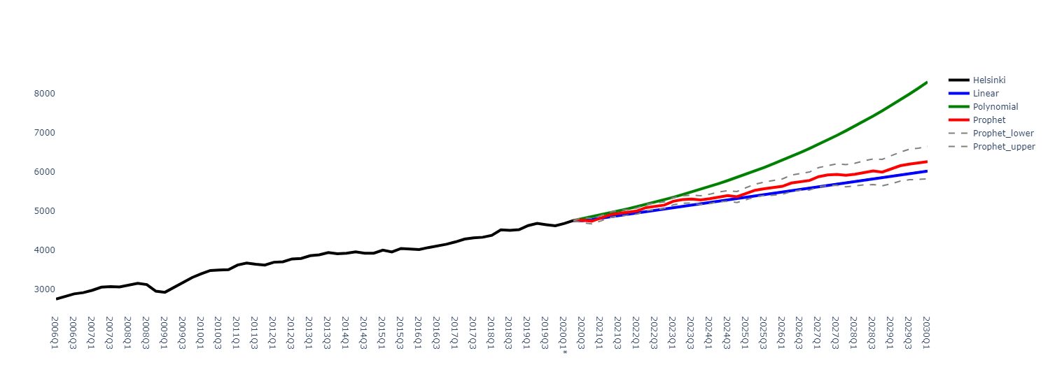
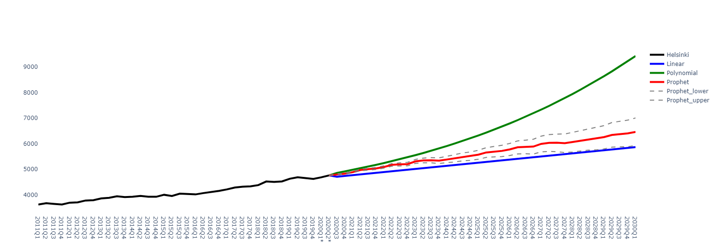

Some test prediction with different start year
Helsinki
Helsinki 2011
Helsinki 2015

Slide 17
Alternative filtering and imputations
Studied the results of the mean square error and filtered the data to start from the optimal year.
Percentage of data missing: 25.016%
Deleting regions that do not have enough data to make the imputations more accurate
How many regions have more than 50%, 60%, 70% and 80% data missing
Which cutting point to use?

Slide 18
Results in one-room flats:
Regions that have less than 50% data:
Regions that have less than 40% data:
Regions that have less than 30% data:
Regions that have less than 20% data:

Slide 19
Results:
Percentage of missing data after cutting regions with more than 50% data missing:
Percentage of missing data after cutting regions with more than 60% data missing:
Percentage of missing data after cutting regions with more than 70% data missing:
Percentage of missing data after cutting regions with more than 80% data missing:

Slide 20
Sarima model
Uses autoregressive and moving average models together to make forecasts.
Takes into account the possible seasonality and non-stationarity of the time series.
The stationarity of a time series is determined by using the augmented Dickey-Fuller test, and differencing is used to make the series stationary if needed.
To determine the order of the sarima model, autocorrelation and partial autocorrelation functions are calculated once the series has been made stationary.
From the acf and pacf we can determine the order of the model by looking at the lags, or bars in our plot.

Slide 21
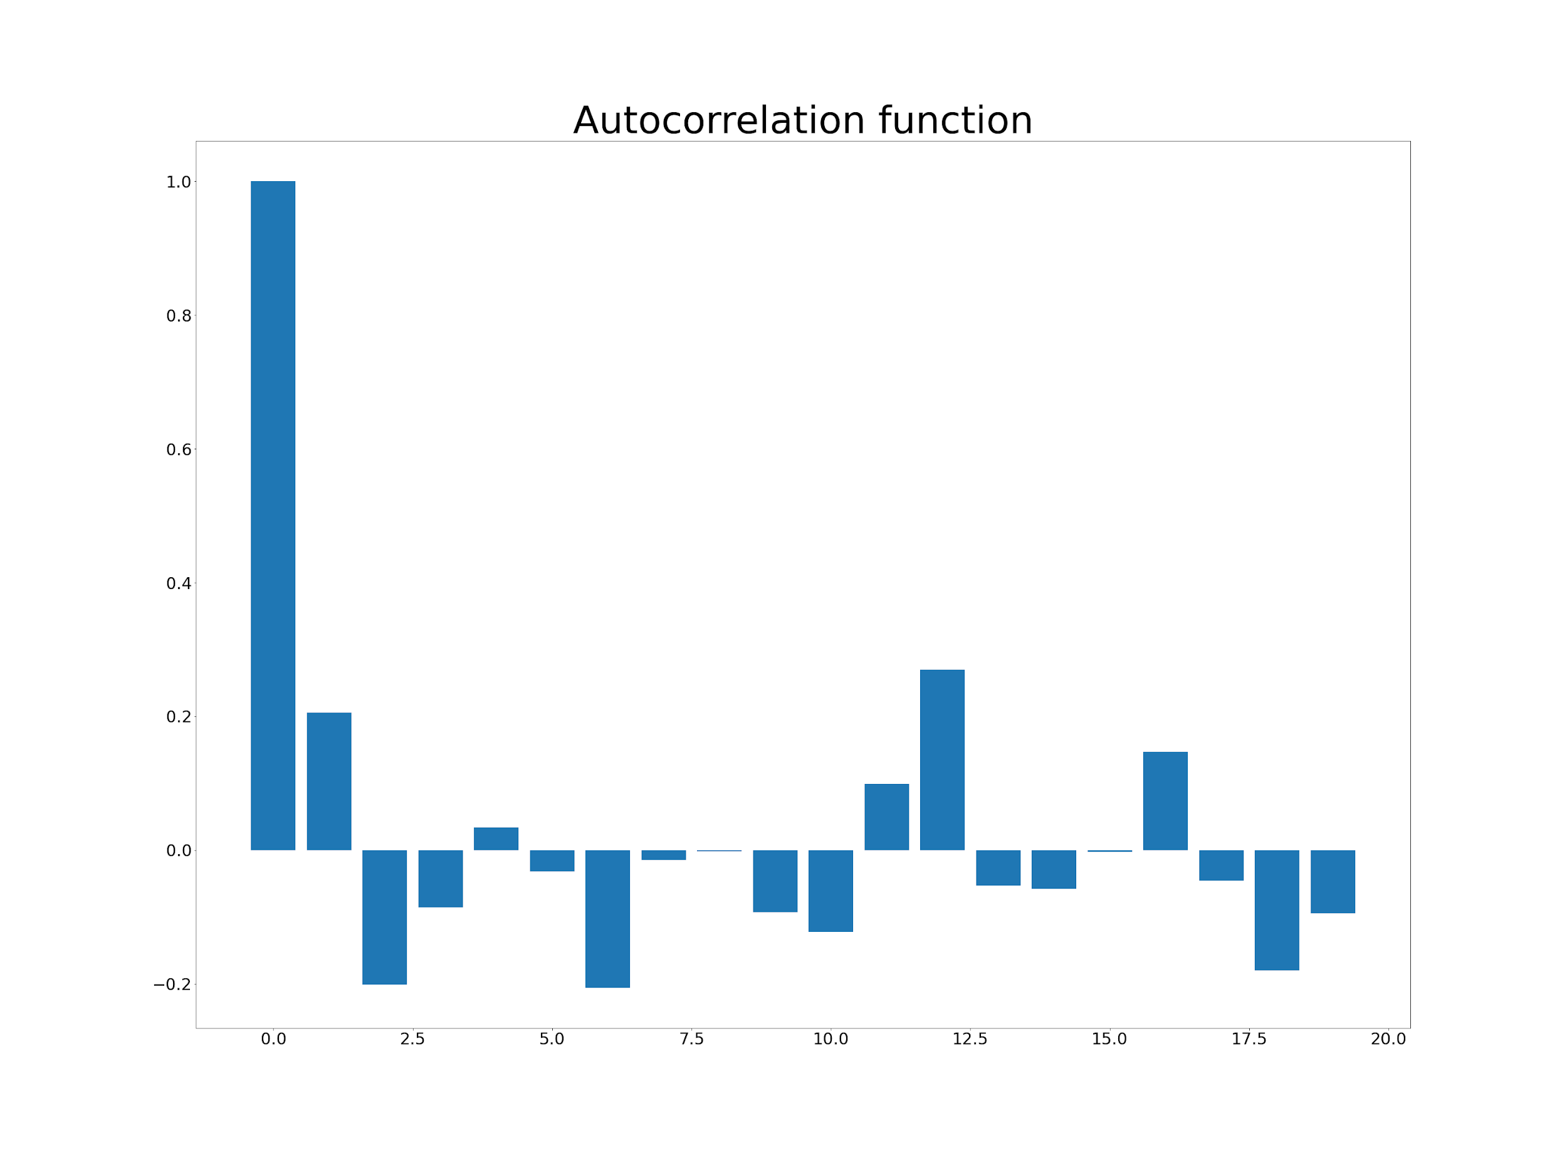
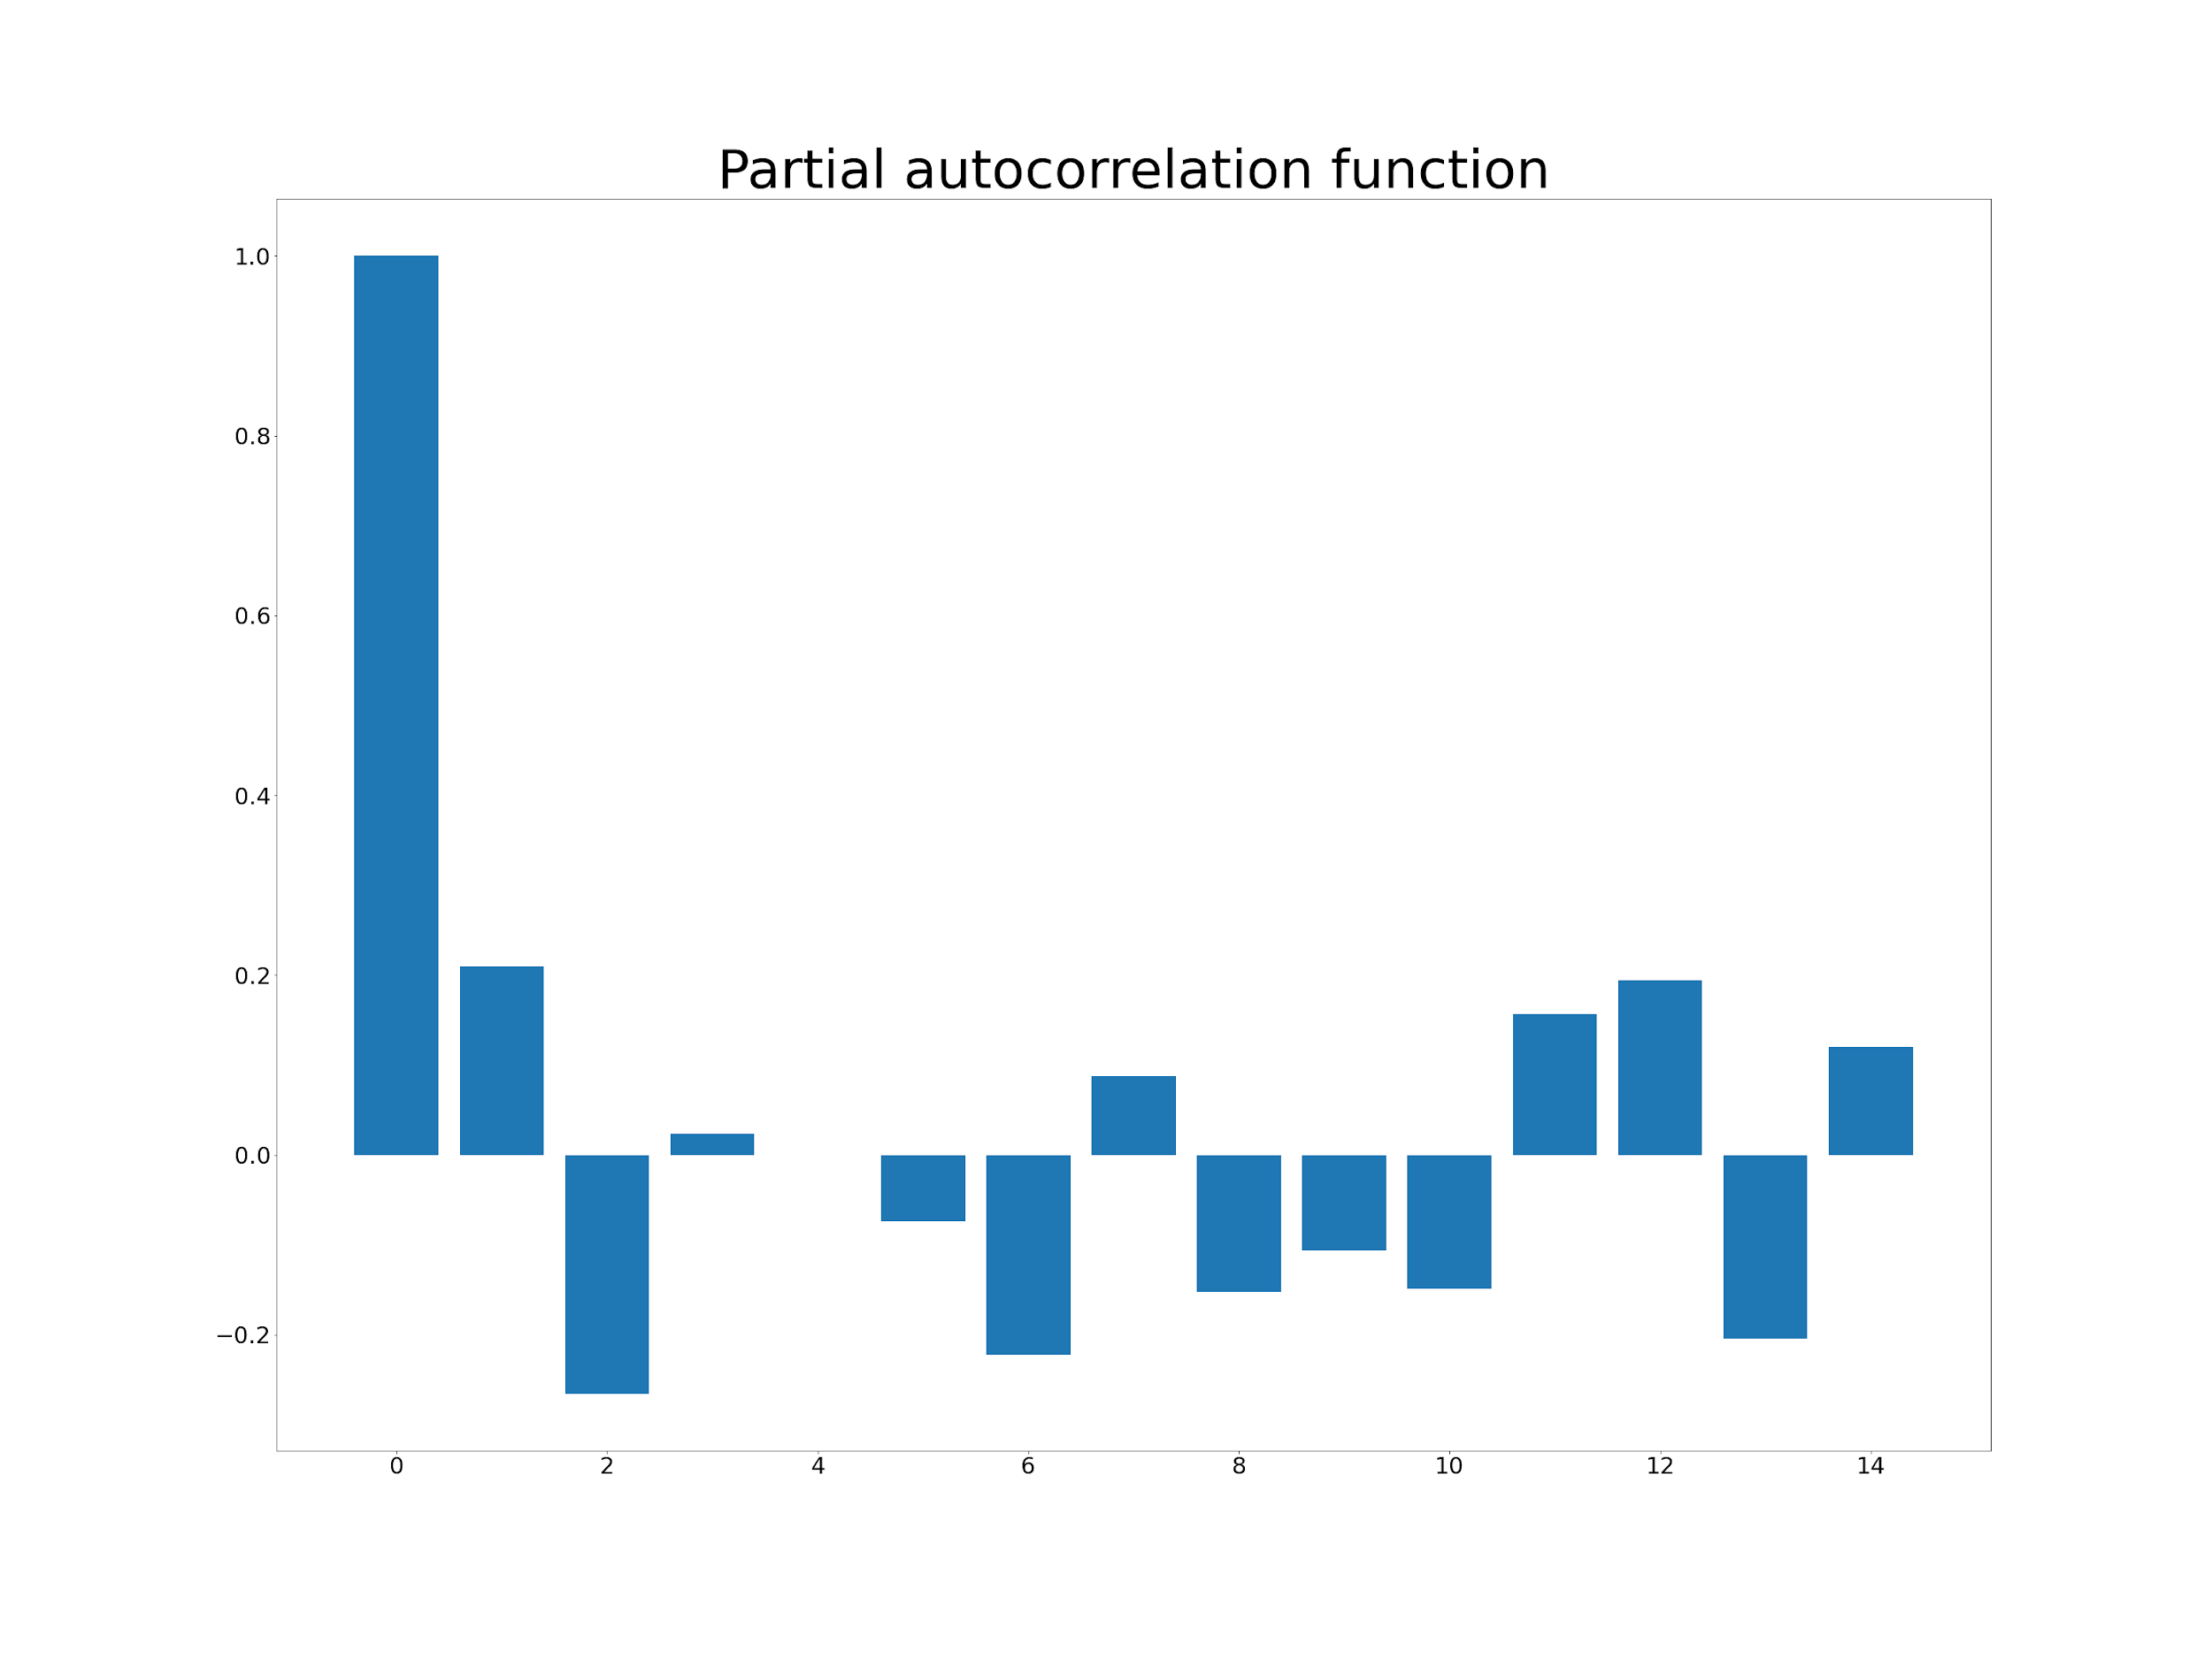
ACF and PACF

Slide 22
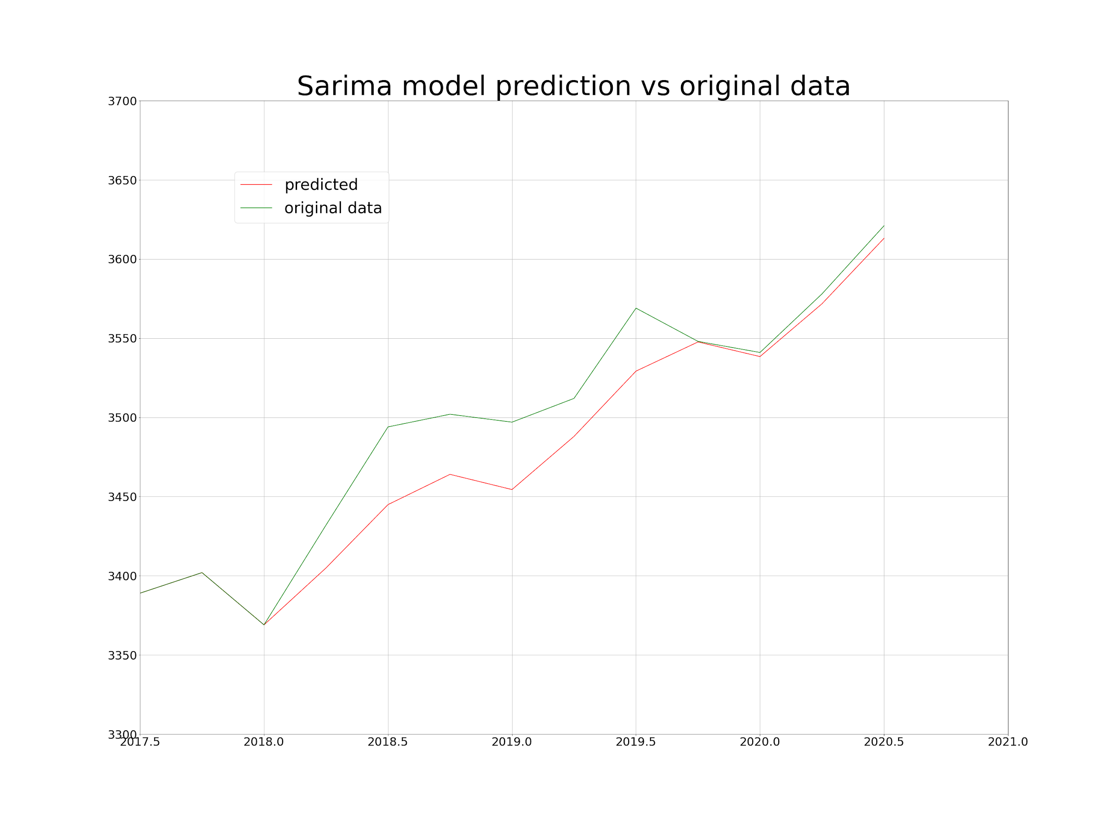
Applying the model on data
Sarima(2,1,2)(1,0,1)_4 model is chosen after looking at the acf and pacf.
The model is applied on the data from 2006Q1 until 2017Q4 and making predictions on the data from 2018Q1 to 2020Q2.
The prediction gives a mean squared error of 865.9607 and a mean absolute error of 23.7544.

